Slide 1
Data Mining Term Paper
Presentation on
Comparative Study of Dimensionality Reduction in High-Dimensional Data

Slide 2
Objective
The goal of this paper is to analyze the below 4 mentioned techniques of Dimensionality Reduction
PCA (Principal Component Analysis)
t-SNE (t-Distributed Stochastic Neighbor Embedding)
LDA (Linear Discriminant Analysis)
Autoencoders

Slide 3
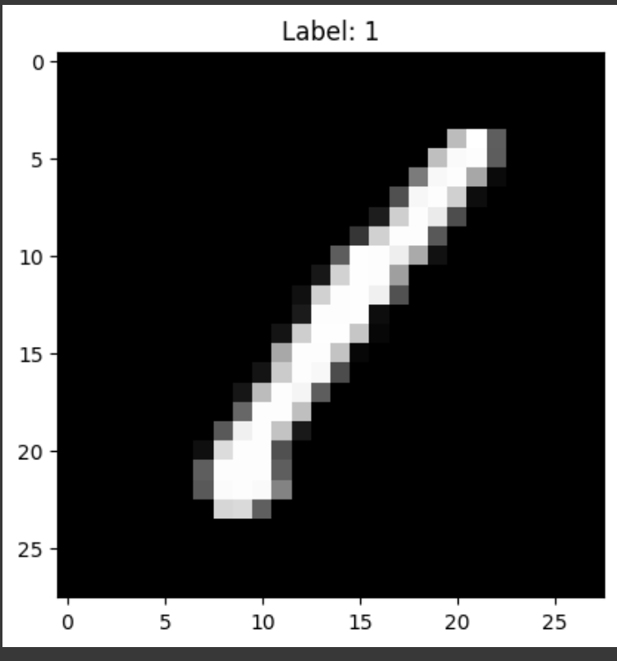
Dataset Overview : Digit Recognizer
Source : Kaggle " https://www.kaggle.com/competitions/digit-recognizer/data?select=train.csv "
The Kaggle Digit Recognizer dataset is a CSV-based representation of the MNIST dataset
Majority are zeros (background), with non-zero values forming the digit.
Train.csv | 42,000 images | Label (digit 0-9) , 785 Columns 6.3 million non-zero pixel values , Sample of non-zero pixel values: [188. 255. 94. 191. 250. 253. 93. 123. 248. 253.] Lower pixel values (closer to 0): Represent darker shades Shape (42000,785) pixel values are stored as integers between 0 and 255
Test.csv | 28,000 images | No labels

Slide 4
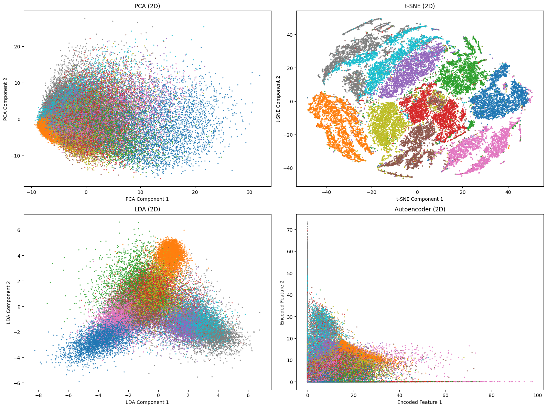
Implementation
Reduced 784D TO 2D for Data Visualization using all 4 techniques

Slide 5
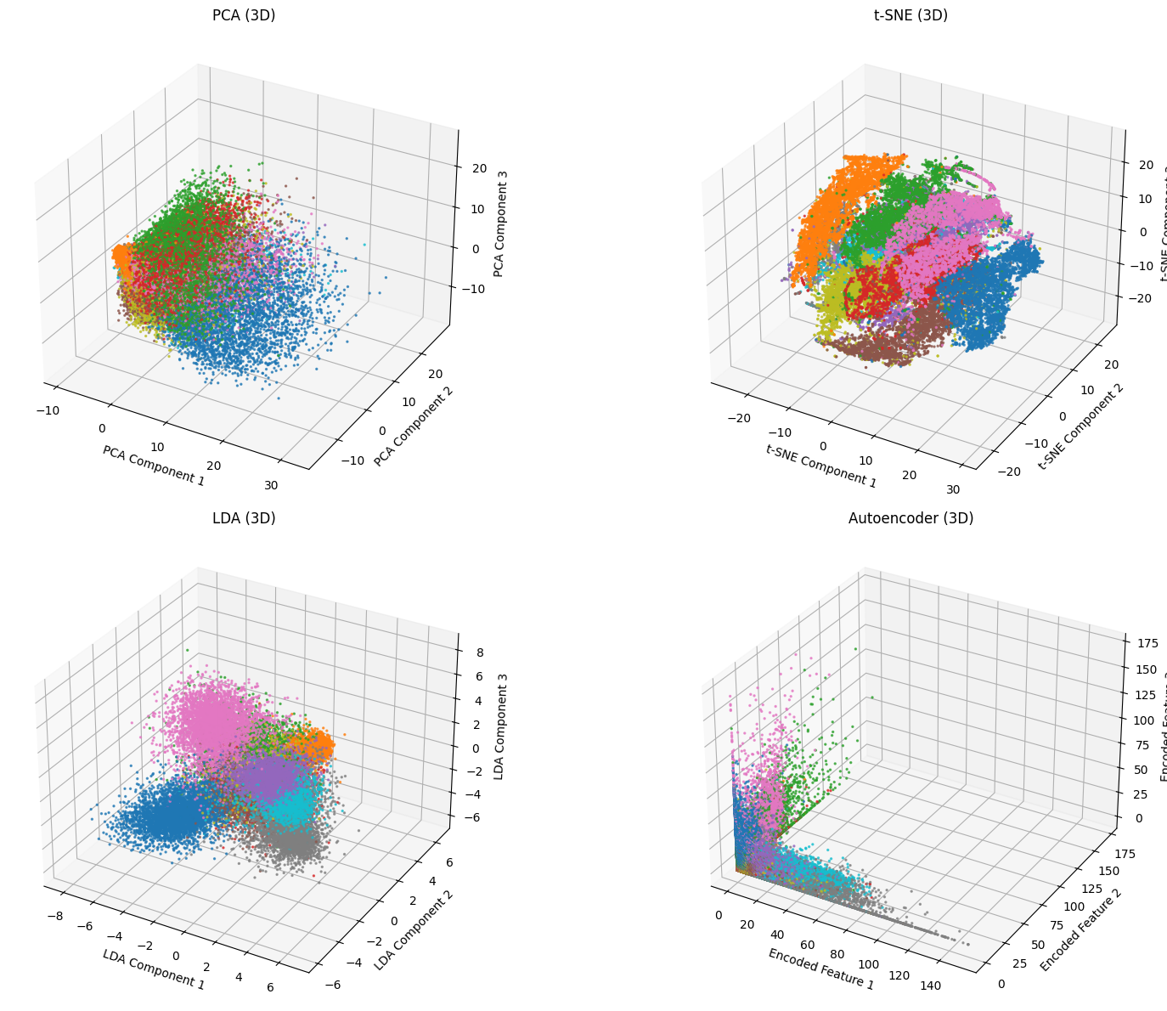
2. Reduced 784D to 3D

Slide 6
Observations
t-SNE: Shows the clearest clustering, making it ideal for visualizing complex, non-linear structures or relationships in the data.
LDA: Performs exceptionally well when class labels are provided(that is our case), ensuring clear separation of different classes.
PCA: Captures global structure and linear variance but might fail to clearly separate complex non-linear structures.
Autoencoders: Offer a more flexible and powerful way to capture non-linear features, though the separation and clarity of clusters may vary depending on tuning.

Slide 7
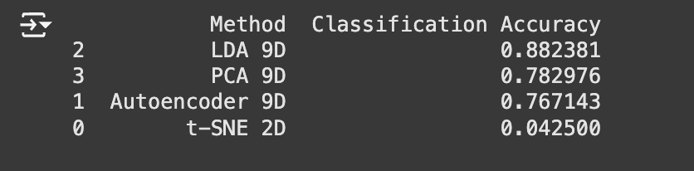
3. Reduced 784D TO 9D to compare the accuracy
LDA : Best for classification as it maximizes class separability using labels, making it ideal for Logistic Regression.
PCA : Performs moderately well; preserves variance but not class separability.
Autoencoder : Captures non-linear features but less suited for linear classification without further tuning.
t-SNE : Poor for classification; designed for visualization, not feature extraction. It is computationally expensive, especially for large datasets, as it needs to compute pairwise similarities for every pair of points in the dataset.

Slide 8
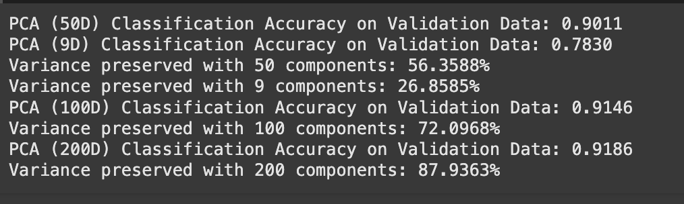
4. PCA : Comparision between 9D,50D,100D,200D
PCA Dimensions | Classification Accuracy | Variance Preserved
9D | 0.7830 | 26.8585%
50D | 0.9011 | 56.3588%
100D | 0.9146 | 72.0968%
200D | 0.9186 | 87.9363%

Slide 9
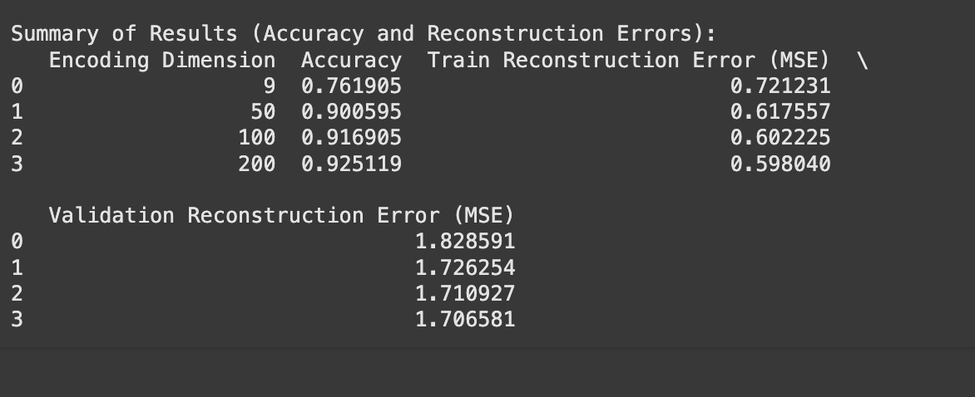
5. Autoencoder : Comparison between 9D,50D,100D, 200D
Encoding Dimension | Accuracy | Train Construction Error (MSE) | Validation Reconstruction Error
9D | 0.761905 | 0.721231 | 1.828591
50D | 0.900595 | 0.617557 | 1.726254
100D | 0.916905 | 0.602225 | 1.710927
200D | 0.925119 | 0.598040 | 1.706581

Slide 10
Challenges faced
TSNE
t-SNE is computationally expensive.
Unable to analyze for d>3 because of the CPU and memory limitation.
LDA
LDA can reduce the dimensionality of the data at most to (number of classes - 1) dimensions.
With 10 classes, the algorithm can find only 9 linear discriminants, since each discriminant represents a decision boundary between class pairs.

Slide 11
Conclusion
Data Visualization Analysis : T-SNE and LDA performs well with logistic regression for handwritten digit recognition multiclass task.
Classification Analysis: LDA and PCA performed well with LR.
The choice of dimensionality reduction should align with the specific purpose .

